Slide 1

A Data Talk on
Consumer Goods Ad_Hoc Insights
A Walkthrough on the business insights that adds value and serves to create or improve company growth.
Sainath Kollipara
Applicant as Junior Data Analyst

Slide 2










ATLIQ HEALTH SAFETY SECURITY and ENVIRONMENT
PLEASE REVIEW THE FOLLOWING FOR YOUR LOCATION
VIRTUAL MEETING REMINDERS
Do not take this call while driving, even when using headset or hands-free
Know the name of the building, room and floor number
Keep you microphones on mute unless you like to ask a question during the Q&A
You may submit questions at any time by typing a question in the chat box
Be familiar with sound of the fire alarm
Phone number for emergency
When using a headset, ensure you are still able to hear the fire alarm
Location of first aid kit and/or first aider
Please close all other applications to maintain focus

Slide 3
Agenda
Introduction
Problem Statement
Business Insights
Appendix
Q&A
Thank You

Slide 4

Introduction
Atliq Hardware, is one of the leading computer hardware producers in India and well expanded in other countries too.
Our Goal
We highly focus on the customer satisfaction by providing quality products and take an innovative approach to achieve the goal.
Our Vision is very strong – high in commitment and feels valued, respected and believing on results.
Our Motive, We at Atliq share a set of core values honesty, integrity and respect for people.

Slide 5

Problem Statement
After conducting an internal audit with the Executive Management involved, they have been noticed that there are lots of data stored with no use.
The management observed that they do not get enough insights to make quick and smart data driven decisions.
They realized to use data to guide strategic business decisions that reaches the company target goals, objectives and initiatives.
There are 10 requested queries from management to provide quick insights from given data source.

Slide 6
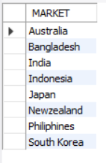
Business Insights
Request 1
Output
Provide the list of markets in which customer "Atliq Exclusive" operates its
business in the APAC region.

Slide 7
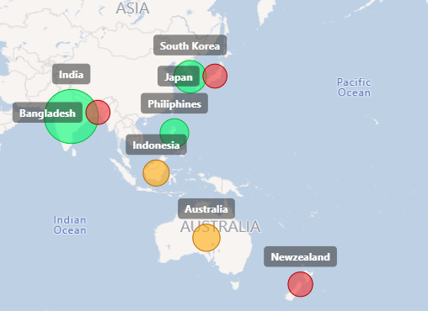
Business Insights
Insights
Output to Visual
In APAC region, ‘Atliq Exclusive’ operates its business in total 8 markets.
India has the highest market value followed by South Korea and Philippines.
Bangladesh, Japan and New Zealand have low market value.

Slide 8

Business Insights
Request 2
Output
What is the percentage of unique product increase in 2021 vs. 2020? The final output contains these fields,
unique_products_2020
unique_products_2021
percentage_chg

Slide 9
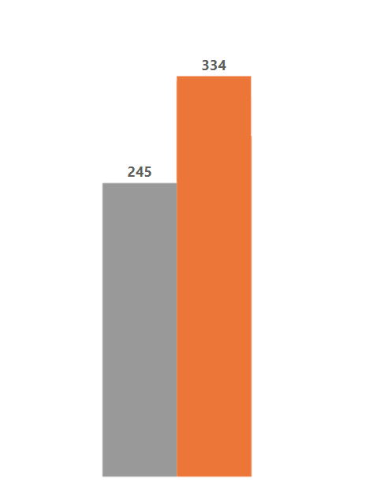
Business Insights
Insights
Output to Visual
There are 89 new products were launched in the year 2021.
We could see the raise of 36.33% on unique products in year 2021 when compared to year 2020.
Unique Products 2020 vs 2021
36.33%
89 New Products
2020
2021

Slide 10
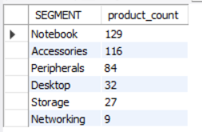
Business Insights
Request 3
Output
Provide a report with all the unique product counts for each segment and sort them in descending order of product counts. The final output contains 2 fields
Segment,
product_count

Slide 11
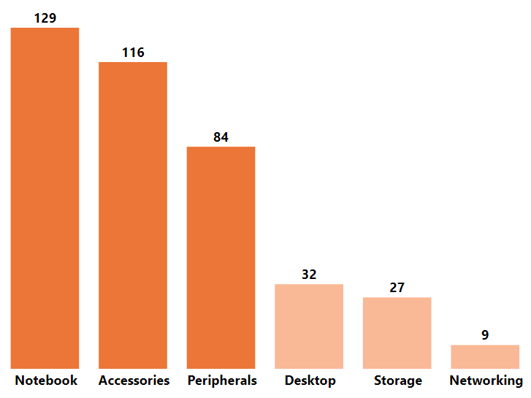
Business Insights
Insights
Output to Visual
The top 3 segments are Notebook, Accessories and Peripherals with an average of 110 unique products in each segment.
Desktop, Storage and Networking are having less average in production.
Need to focus on increasing product count value and marketing to advertise.
Unique Products by Segment
Average 109.66
Average 22.66

Slide 12
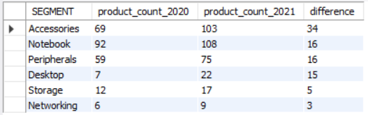
Business Insights
Request 4
Output
Follow-up: Which segment had the most increase in unique products in 2021 vs 2020? The final output contains these fields,
segment
product_count_2020
product_count_2021
difference

Slide 13
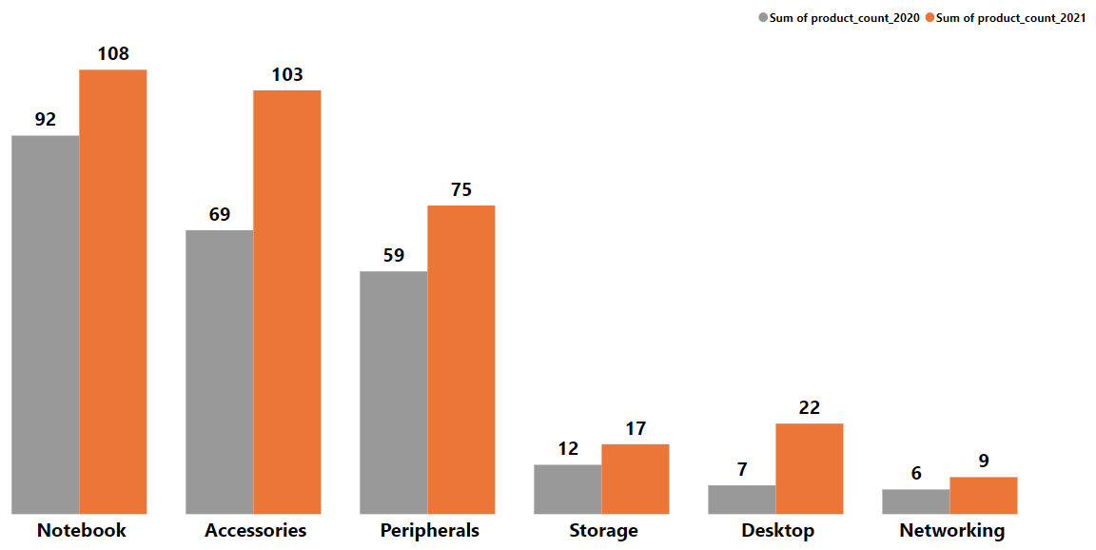
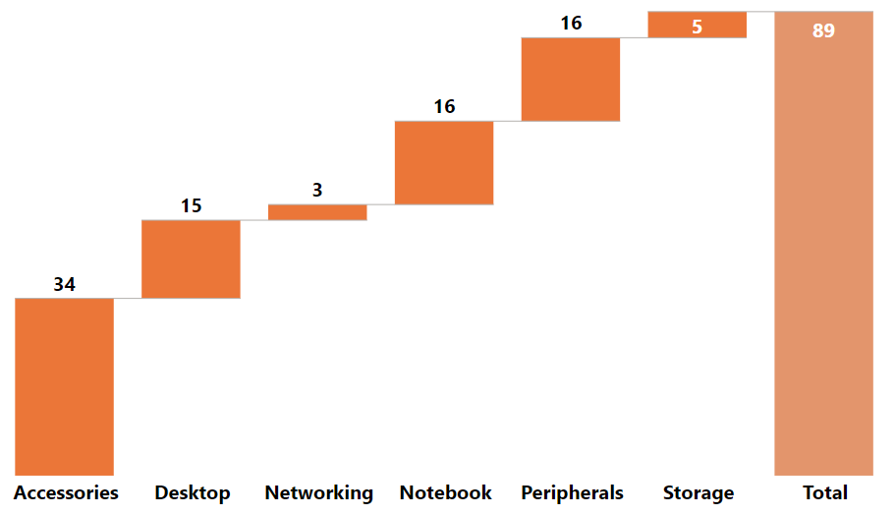
Business Insights
Unique Product by Segment 2020 vs 2021
Increase in Unique Product by Segment
Insights
Accessories tops the list in unique products in 2021 and where Notebook & Peripherals are contributed same.
Networking & Storage are least on unique products. We have to be more innovative on this.

Slide 14

Business Insights
Request 5
Output
Get the products that have the highest and lowest manufacturing costs. The final output should contain these fields,
product_code
product
manufacturing_cost

Slide 15

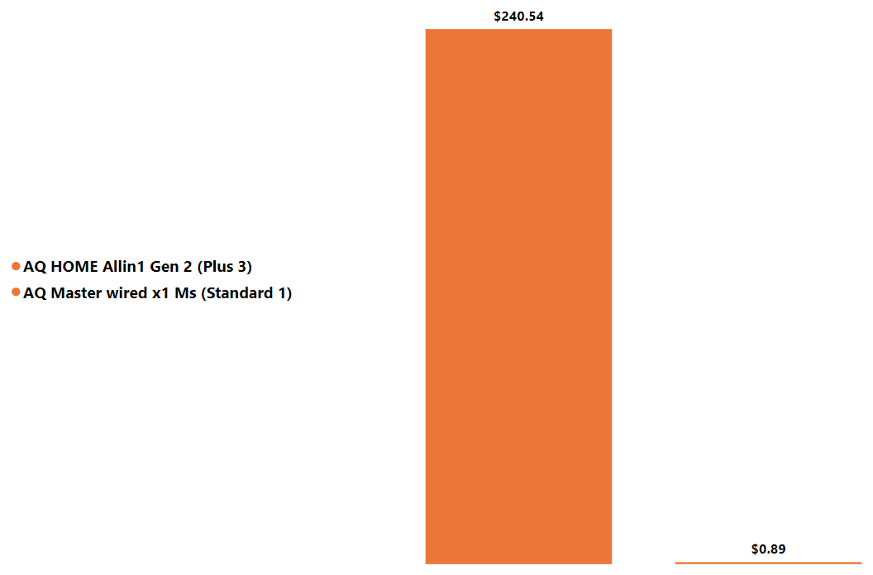

Business Insights
Insights
Output to Visual
Manufacturing Cost on Products
AQ Master wired x1 Ms (Standard 1) has the minimum manufacturing cost on products.
AQ HOME Allin1 Gen 2 (Plus 3) has the maximum manufacturing cost on products.

Slide 16
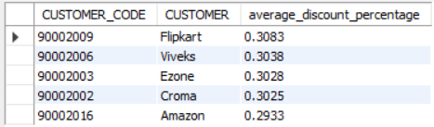
Business Insights
Request 6
Output
Generate a report which contains the top 5 customers who received an average high pre_invoice_discount_pct for the fiscal year 2021 and in the Indian market. The final output contains these fields,
customer_code
customer
average_discount_percentage

Slide 17
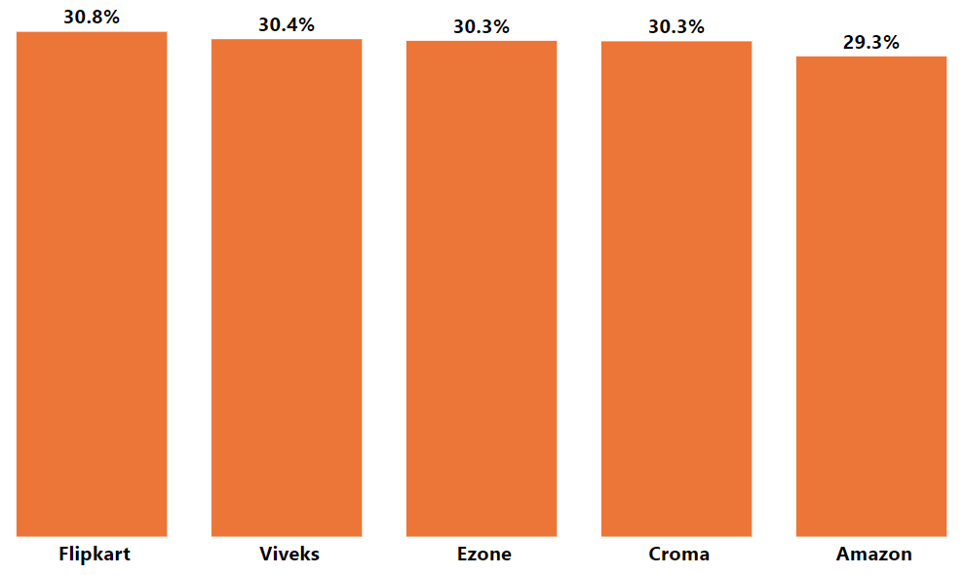
Business Insights
Insights
Output to Visual
Flipkart Viveks, Ezone, Croma and Amazon are received an average high pre invoice discounts percentage for the fiscal year 2021 in India market.
Discount strategies are helps to attract the customers.
Top 5 Customers by PID %

Slide 18
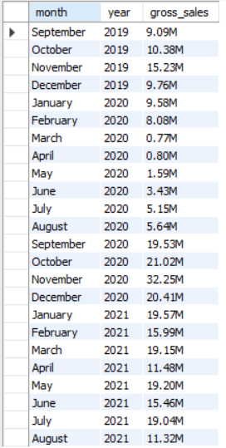
Business Insights
Request 7
Output
Get the complete report of the Gross sales amount for the customer “Atliq Exclusive” for each month. This analysis helps to get an idea of low and high-performing months and take strategic decisions.
The final report contains these columns:
Month
Year
Gross sales Amount

Slide 19
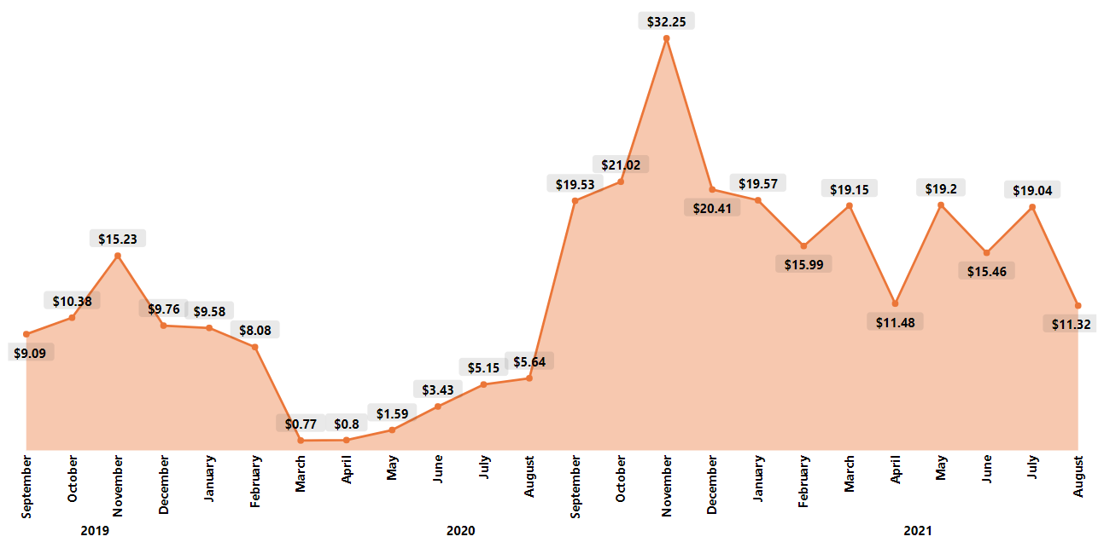
Business Insights
Atliq Exclusive Gross Sales Trend
Output to Visual
Due to pandemic sales were down but on 2021 we have good spikes as well sudden drops
Nov month having constant high spikes on every year.
Insights
On 2019 & 2020 Sept to Dec Atliq Exclusive sales were increasing and here in both the years November month has the big spike.
Sudden drop on sales trend from March 2020 till Aug 2020 due to pandemic.

Slide 20
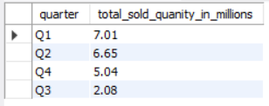
Business Insights
Request 8
Output
In which quarter of 2020, got the maximum total_sold_quantity? The final output contains these fields sorted by the total_sold_quantity,
Quarter
total_sold_quantity

Slide 21
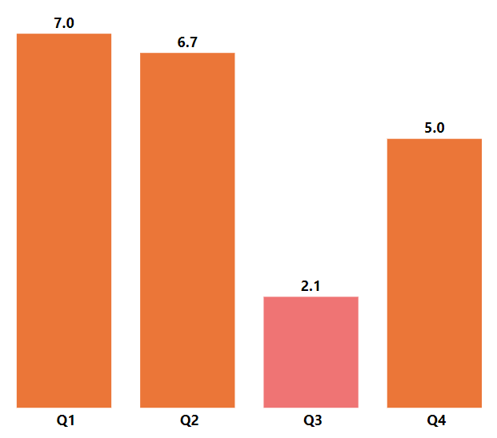
Business Insights
Insights
Output to Visual
Q1 with an 34% & Q2 with an 32% has the most sold quantity products in the fiscal year 2020.
Sudden trough in Q3 with an 10% sold quantity products due to covid-19 pandemic.
Quick spike on Q4 with an 25% on the demand of work from home, online studies many more dependences.
Sold Quantity Products on 2020

Slide 22
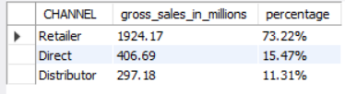
Business Insights
Request 9
Output
Which channel helped to bring more gross sales in the fiscal year 2021 and the percentage of contribution? The final output contains these fields,
channel
gross_sales_mln
percentage

Slide 23
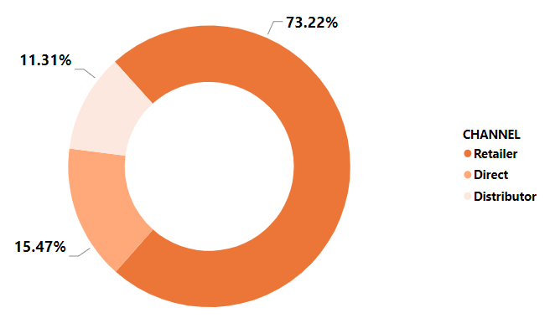
Business Insights
Insights
Output to Visual
Retailer channel is having 73.22% which bring most gross sales in the fiscal year 2021.
Direct and Distributor channels are having less gross sales in the fiscal year 2021.
Gross Sales By Channel

Slide 24
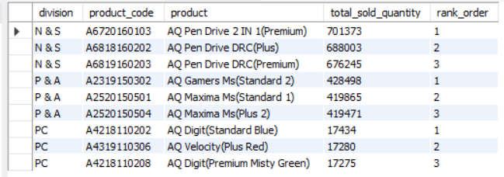
Business Insights
Request 10
Output
Which channel helped to bring more gross sales
in the fiscal year 2021 and the percentage of contribution? The final output contains these fields : division, product_code
product
total_sold_quantity
rank_order

Slide 25
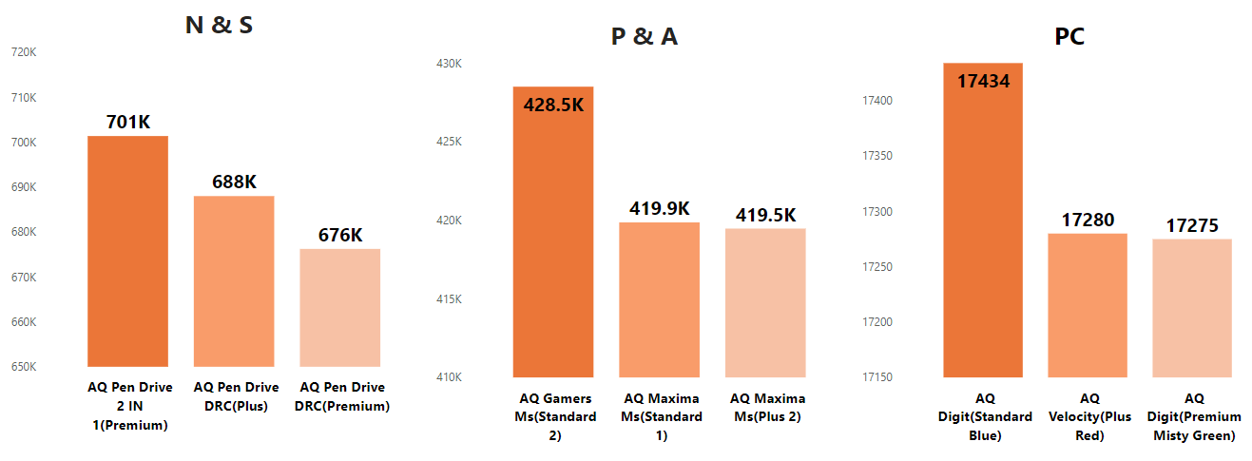
Business Insights
Insights
Output to Visual
The top 3 selling products in N&S were pen drives, which were around 7 lakh in quantity.
The top 3 selling products in P&A were mouse, which were around 4 lakh in quantity.
The top 3 selling products in PC were personal laptops, which were around 17000 in quantity.

Slide 26
Appendix
Due to pandemic from Feb-Aug 2020 sales were down, but on 2021 same period having spikes and sudden drops as well – Take this into consideration.
Appreciate our employees efforts and their contribution during pandemic – Q4 on 2020 fiscal year.
We can continue to have good coordination on retailers as its contribution is high.
'N & S' division have the highest total sold quantity compared to others.

Slide 27
Questions & Answers
Questions & Answers
Q&A
Feel free to ask questions in comment section.
Happy to answer.

Slide 28
Thank You
Thank You

